Slide 1
Real-Time Process Monitoring Dashboard
A Comprehensive System for Monitoring Resource Utilization
By Vasu Rastogi, Arpit Singh, Abhishek Yadav

Slide 2
Introduction
Get ready to dive into the world of real-time process monitoring Dashboard! This presentation is all about how we can keep an eye on resource usage effectively, ensuring everything runs smoothly.

Slide 3
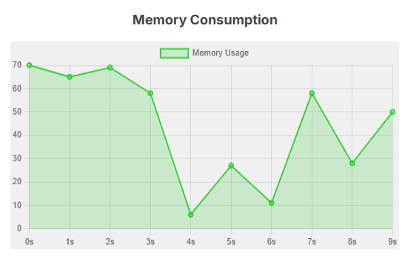
01
Overview

Slide 4
Real-time system monitoring
Real-time system monitoring is about staying on top of what's happening in your system as it happens. Imagine being able to spot issues before they become major headaches! This approach helps you keep everything running smoothly and efficiently.

Slide 5
Importance in computing environments
In today's digital age, real-time monitoring is key to making sure everything works as it should. It helps you catch problems early, optimize performance, and keep users happy. Whether you're managing a data center, a cloud environment, or just your local network, having your finger on the pulse makes all the difference!

Slide 6
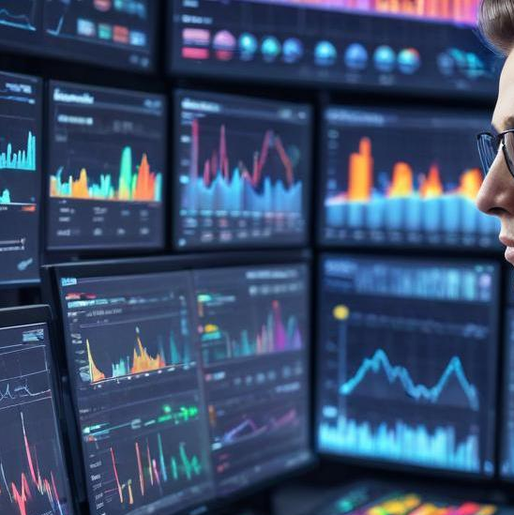
Objectives of Monitoring
The main goals of monitoring systems are pretty straightforward. We want to keep track of everything happening in real-time—like CPU, Memory, and Disk usage—so we can catch problems before they escalate. The aim is to provide clear insights and dynamic visualizations that help us understand how our resources are being utilized and when adjustments might be needed.

Slide 7
GitHub Repository Updates Link
https://github.com/TheVasuRastogi/Real-Time-Process-Monitoring-Dashboard

Slide 8
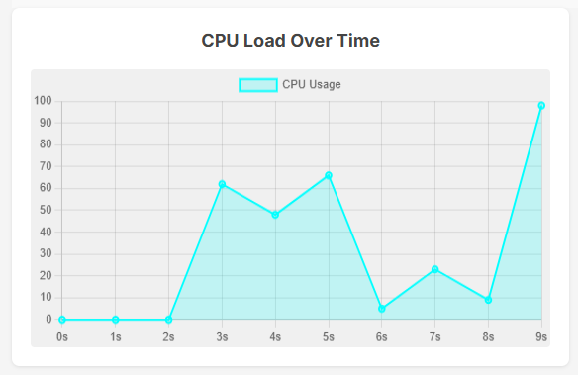
02
Dashboard Features

Slide 9
Real-time charts and graphs
One of the coolest features of our dashboard is the real-time charts and graphs. These visual tools give you an instant snapshot of your system's health. You can see patterns and trends at a glance, meaning you can respond quickly if something's not quite right.

Slide 10
Alerts and monitoring
Having good alert systems in place is crucial. Our dashboard can notify you when resource usage hits a certain threshold—like when CPU usage spikes unexpectedly. This way, you can be proactive and tackle issues before they impact performance.

Slide 11
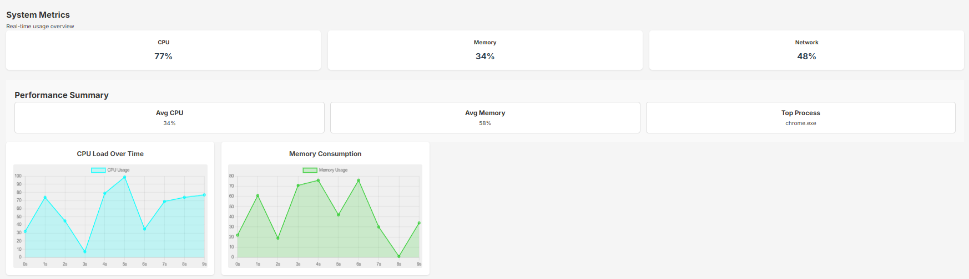
Customization options
Customization is where you can really make the dashboard yours! You can select what metrics you want to see, rearrange elements to suit your workflow, and set up personalized alerts. This flexibility makes it easier to focus on what matters most to you.

Slide 12
Conclusions
To wrap it up, a real-time process monitoring dashboard is your best friend for effective system management. It helps you keep an eye on things, catch issues early, and stay ahead of performance concerns. With features like real-time visuals, alerts, and customization, it empowers you to make informed decisions and keep your systems running seamlessly.

